Slide 1
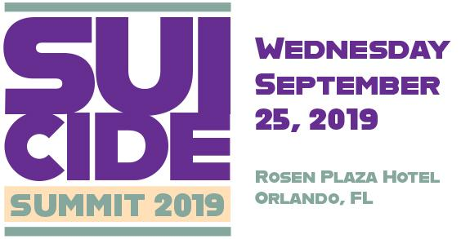
Notes:
Good morning. My name is Bill Gardam, I am the CEO of Peace River Center, a full-service community mental health center serving Polk, Highlands and Hardee Counties since 1948.
We serve over 25,000 patients a year through 30 programs provided in 27 locations and offering traditional inpatient and outpatient services and operating a psychiatric crisis line and mobile crisis response team for over 17 years that specifically responds to crisis calls and suicide issues.
I am also the Board Chair of the Florida Behavioral Health Association now proudly representing over 72 of Florida’s behavioral health providers statewide.
I am pleased to be here with you today to open this year’s Behavioral Health Innovation Summit with a focus on Suicide Awareness, Assessment & Prevention.

Slide 2
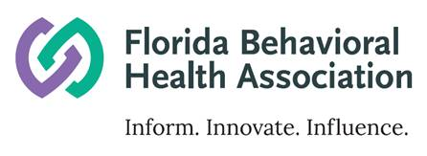


Notes:
I would like to thank Otsuka Pharmaceutical Development and Commercialization (OPDC) and specifically Dr. Jacque Canning and Diana Schmidt and Magellan Complete Care for being wonderful partners and sponsors along with the Florida Behavioral Health Association and behavioral health providers across Florida.
We know that by working together with you and many others that we can and do make a difference one day and one life at a time.

Slide 3
United States and Florida
Suicide Statistics
Florida Innovation Summit, 2019
J. William Gardam, MBA
CEO and President, Peace River Center
for Personal Development, Inc.
Bartow, FL
Notes:
I would also like to acknowledge and thank our speakers and attendees today.
Looking around the room I see a wonderful turnout for this very important topic.
Such a response to this event is gratifying to see because to really make strides in reducing the rate of suicide in Florida, the involvement of the whole community is essential.
I would particularly like to extend a warm welcome and thank you to:
- Dr. Brian Ahmedani, a leading expert and principle investigator on suicide prevention and the Zero Suicide Project Model;
- Mary Mahew, Secretary for the Agency for Health Care Administration; and
- Rodney Moore, Assistant Secretary for Substance Abuse and Mental Health for the Department of Children and Families
And, of course all of our presenters.

Slide 4
United States Suicide Statistics
In 2017, 1,400,000 people attempted suicide in the US.¹
47,173 Americans died by suicide in 2017. An average of 129 suicides occur each day.¹
White males accounted for 69.67% of suicide deaths in 2017; highest in middle-age men.
Suicide costs the United States $69B annually¹
The adult rate of completed suicides has increased by 30% over the last decade²
https://afsp.org/about-suicide/suicide-statistics/
https://www.crisistextline.org/blog/change-the-stats
Notes:
On Wednesday, March 14th, an 11th-grader at Lake Mary High School north of Orlando died by suicide from a single gunshot in the school's auditorium. The student had asked to use the bathroom with 10 minutes left in the first period of classes.
One suicide is too many. Yet 1.4 million people attempted suicide and more than 47,000 Americans died in 2017 as a result of suicide… with approximately one death every 12 minutes.
35 deaths will take place across our nation during the time of our conference today.

Slide 5
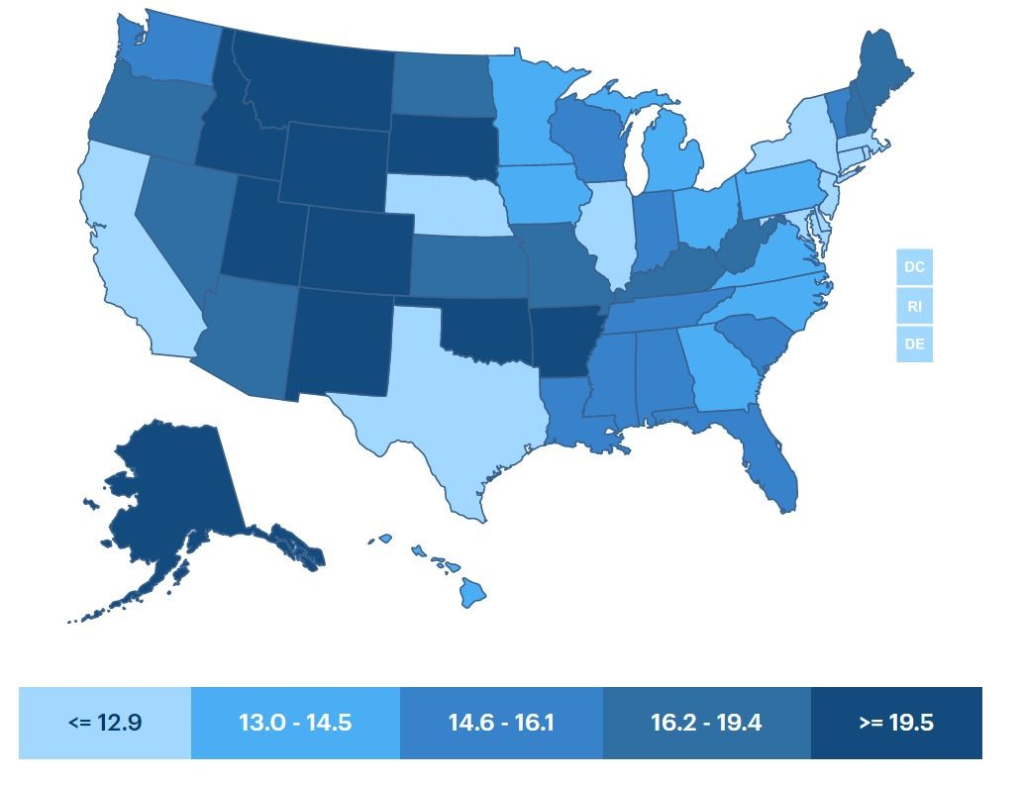
US Suicide Death Rate Map per 100,000, 2017
https://www.americashealthrankings.org/explore/annual/measure/Suicide/state/ALL?edition-year=2017
Notes:
Suicide is now the 10th leading cause of death in the United States for all ages.
And, as you can see in this national map, the rate per 100,000 population shows that not all states are equal – there are many states with high rates of death by suicide and those with fewer – but none are immune.
There is a four-fold variance across our nation; from 6.9 per 100,000 residents in Washington, D.C. to 29.2 per 100,000 residents in Montana.

Slide 6
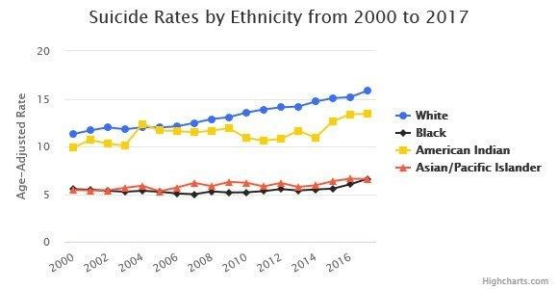
United States Suicide Statistics
https://afsp.org/about-suicide/suicide-statistics/
Notes:
Likewise, no ethnicity is immune… as shown in this map with suicide rates from the year 2000 to 2017 by ethnicity.

Slide 7
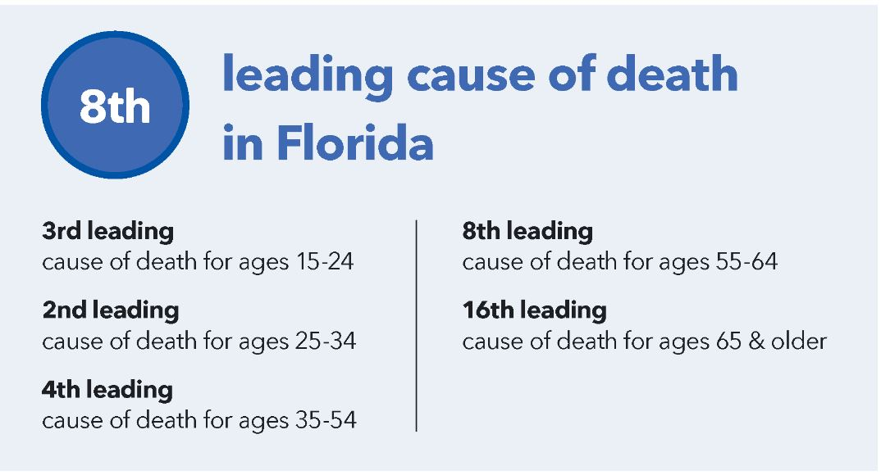
Florida Suicide Statistics
On average, 1 person dies by suicide every 3 hours in Florida
Nearly 4X as many people died by suicide in Florida in 2017 as compared to in alcohol-related motor vehicle accidents.
Suicide cost Florida $2,841,739,000
Combined lifetime medical and work loss cost in 2010.
https://afsp.org/about-suicide/state-fact-sheets/#Florida
Notes:
In Florida death by suicide is:
- 3rd leading cause of death among our youth (ages 15-24);
- 2nd leading cause of death among young adults (ages 25-34); and,
- 4th leading cause of death among middle-age adults (ages 35-44 and ages 45-54, respectively).
As Florida’s data suggests, youth, in particular, continue to be at-risk.
Approximately 15% of US high school students report that they've been bullied online in the past year, according to the CDC. And, a Pew Research Center survey found that the number could be closer to 59%.
In 2013, Florida’s children and youth represented…
• over 4,700 (4,752) Emergency Department visits for suicide attempts;
• over 1,900 (1,909) hospitalizations for suicide attempts; and,
• 246 suicide deaths (280 deaths in 2014).
The suicide rate for teens between the ages of 12 and 17 jumped 77 percent between 2007 and 2017.
One child dies by suicide every 32 hours in Florida.

Slide 8
Florida Suicide Statistics, 2018
Deaths by suicide = 3552¹
Death rate per 100,000 = 15.3¹
Florida’s suicide rate increased 10.6 percent from 1999 to 2016, though most US states saw larger increases²
http://www.flhealthcharts.com/charts/DataViewer/DeathViewer/DeathViewer.aspx?indNumber=0116
https://www.floridatrend.com/article/24727/suicide-rates-rising-in-florida-and-across-the-us
Notes:
As most of you know, many factors contribute to suicide. But an important research finding that is not often discussed is that more than half of people who died by suicide did not have a known diagnosed mental health condition at the time of their death.
Relationship problems or loss, substance misuse; physical health problems; and job, money, legal and/or housing stress often contributed to risk for suicide.
The national suicide rate average in 2017 was 14.0 per 100,000 population. (2014-2016).
In 2018, there were 3,552 deaths in Florida due to suicide; making suicide the 7th highest cause of death and translating into an average of 15.3 suicides per 100,000 residents in Florida which is a 10.6% increase from 1999 to 2016; 10% higher than the national average; and the highest rate of suicide in Florida in the past 10 years.

Slide 9
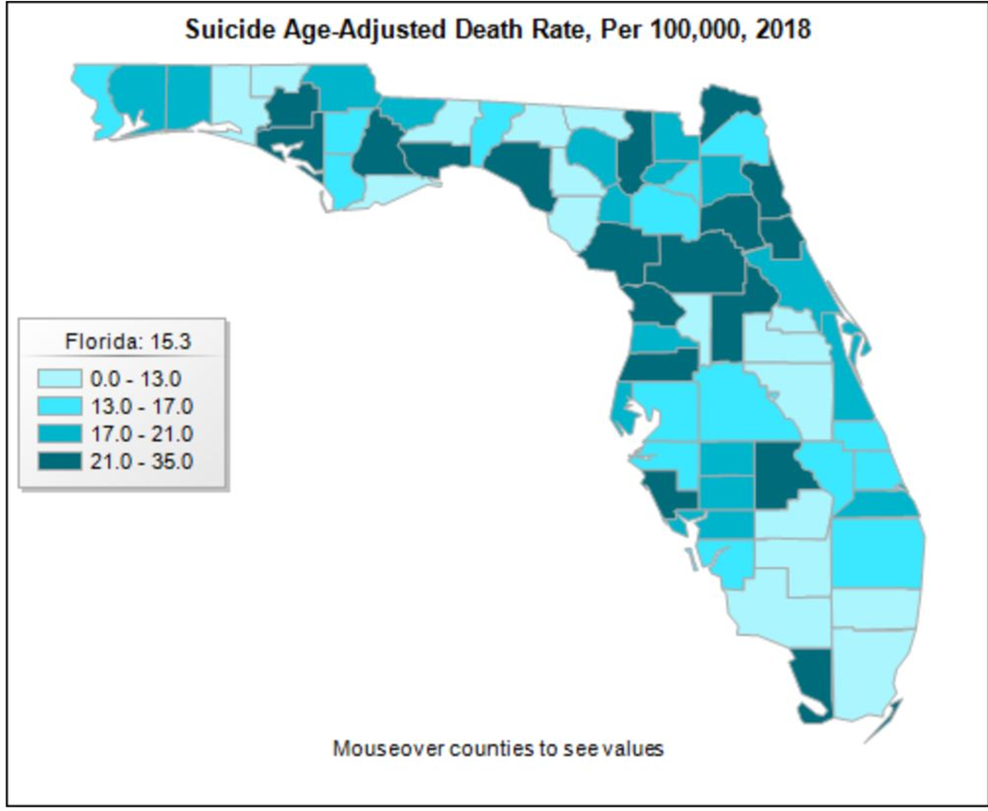

Florida 2018 Suicide Age-Adjusted Death Rate, per 100,000
http://www.flhealthcharts.com/charts/DataViewer/DeathViewer/DeathViewer.aspx?indNumber=0116
Notes:
Similar to the national map, Florida’s death by suicide rates are varied across the state.

Slide 10
Suicide Rates Top 10 Florida Counties per 100,000
2018 age-adjusted suicide rates
2018 age-adjusted suicide rates
Monroe 34.87
Washington 33.59
Citrus 30.88
Putnam 29.65
Highlands 28.92
Marion 24.97
Levy 24.94
Flagler 24.77
Bay 23.89
Columbia 23.13
http://www.flhealthcharts.com/charts/DataViewer/DeathViewer/DeathViewer.aspx?indNumber=0116
Notes:
The Florida Top 10 counties sorted by Age Adjusted Suicide Rate per 100,000 population shows Monroe County at the top of the list with a rate of 34.87 per 100,000 population down to Columbia County at a rate of 23.13.
Sorting in this fashion has the Top 10 Counties representing 348 suicide deaths and only approximately 9.8% of the total deaths by suicide in Florida.

Slide 11
Suicide Rates Top 10 Florida Counties by count
2018 age-adjusted suicide counts
2018 age-adjusted suicide counts
Miami-Dade 278
Broward 260
Palm Beach 247
Pinellas 219
Hillsborough 217
Duval 164
Orange 147
Lee 130
Brevard 128
Volusia 125
http://www.flhealthcharts.com/charts/DataViewer/DeathViewer/DeathViewer.aspx?indNumber=0116
Notes:
Re-sorting the Top 10 list to show suicide count by county gives us a totally different list. This new Top 10 list shos Miami-Dade County with the largest number of deaths by suicide and Volusia county with the lowest but still over 100. The total count here represents 2,240 deaths by suicide or 63% of deaths by suicide across Florida…
Looking at all of the county data… there are 5 counties with over 200 deaths by suicide… 8 counties with over 100 but less than 200… 10 with between 50 and 99… and 17 counties with 5 or less deaths by suicide. BUT, only 1 county, Lafayette County had zero deaths by suicide.
In Polk County, where I live, there were 103 deaths by suicide in 2018 resulting in a rate of 14.6 suicides per 100,000 residents. This was also the highest count and highest rate per 100,000 population in over 10 years.

Slide 12
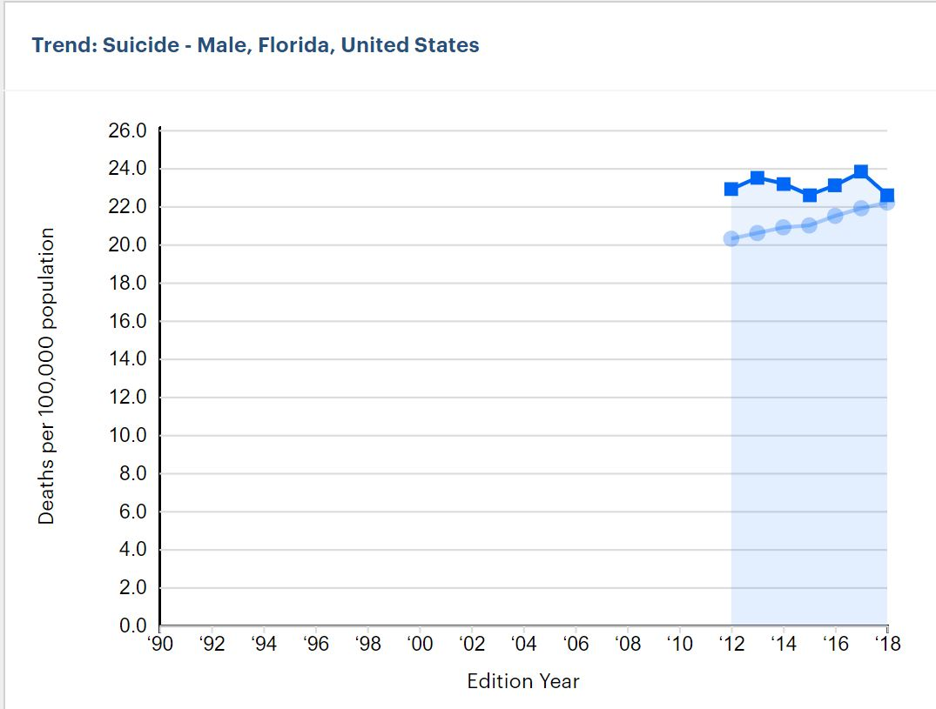
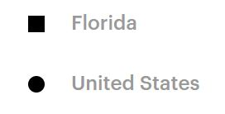
Age-adjusted number of deaths among males due to intentional self-harm, per 100,000 population
CDC WONDER Online Database Underlying Cause of Death, Multiple Cause of Death files
https://www.americashealthrankings.org/explore/annual/measure/Suicide/population/suicide
Notes:
Looking briefly at deaths by suicide by gender reveals some interesting data. The number of deaths by suicide among males has been steadily increasing nationwide since 2012 while the number among males in Florida showed an increase from 2015 through 2017 and a decrease in 2018…

Slide 13
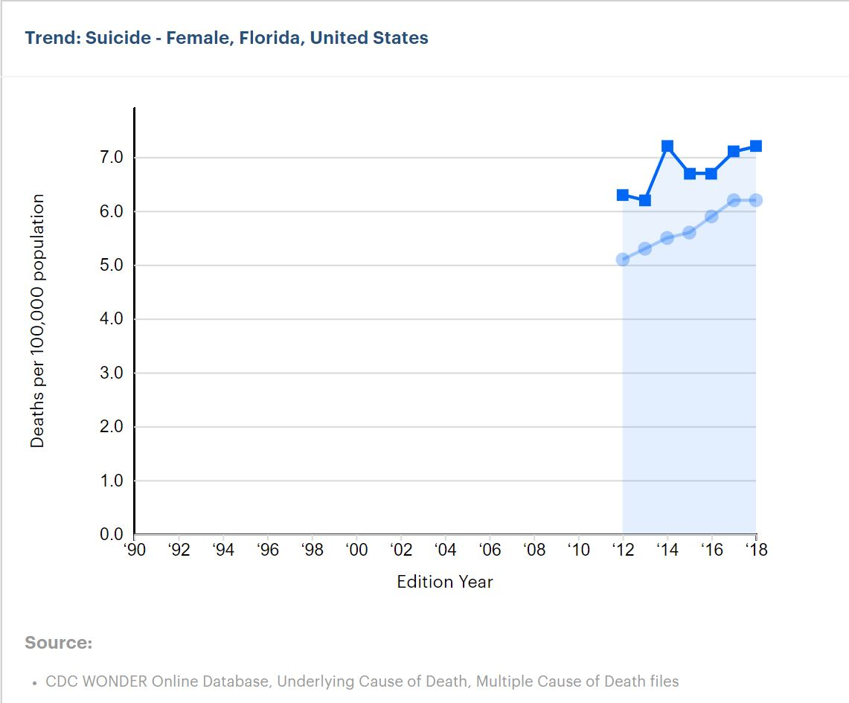
Age-adjusted number of deaths among females due to intentional self-harm, per 100,000 population
CDC WONDER Online Database Underlying Cause of Death, Multiple Cause of Death files
https://www.americashealthrankings.org/explore/annual/measure/Suicide/population/suicideL
Notes:
while the number of deaths by suicide among females showed a steady increase nationally in 2012 through 2017 and a leveling off in 2018 while in Florida there was a mix of increases and decreases since 2013 but a slight slowdown on the rate of increase from 2017 to 2018.

Slide 14
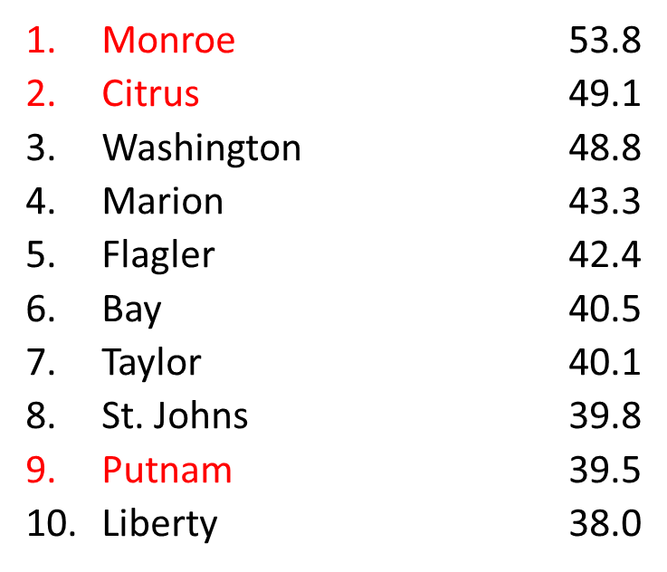
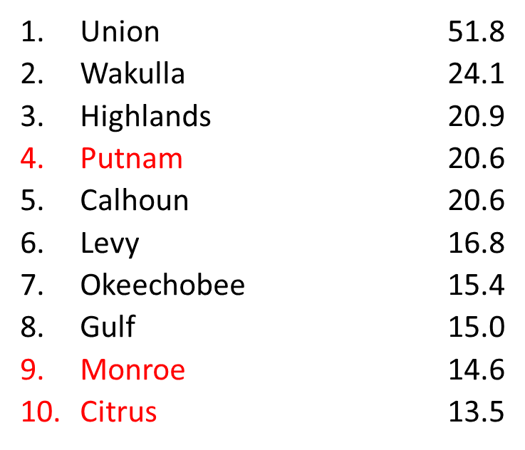
Suicide Age-Adjusted Rates per 100,000
Top 10 Counties, Males vs. Females
Males, 2018
Females, 2018
http://www.flhealthcharts.com/charts/DataViewer/DeathViewer/DeathViewer.aspx?indNumber=0116
Notes:
This table is interesting and emphasizes the difference between males and females.
Just one example is that Monroe County has the highest rate of deaths by suicide per 100,000 population for males at 53.8 per 100,000 which represents a count of 30 deaths. While Monroe County ranked 9th in the rates of deaths by suicide per 100,000 population at 14.6 but this represented 5 deaths by suicide.
And, while Marion County ranked 4th here for males with a rate of 43.3 and a count of 76 deaths, it did not make the top 10 for females with a rate of 8.2 per 100,000 and a count of 15.
In general, females will actually attempt suicide more often than males but males have a higher completion of death by suicide. In our statewide data of 3,552 suicides in 2018, 21.6% (767 or 6.6 per 100,000 population) were by females and 78% (2,785 or 24.7 per 100,000 population) by males.

Slide 15
Over 80% of individuals make healthcare contacts before suicide.
38% of individuals had a healthcare visit within 1 week before suicide attempt.
~95% had a healthcare visit within the preceding year.
Ahmedani BK Med Care 2015 May;53(5):430-435
Notes:
Suicide is a pervasive theme, the world over and there is no doubt that SUICIDE is a public health crisis.
There are many things all of us can do to help address mental illness and suicide issues.
A simple thing to do is to just be there in the moment with someone.
During this past year, our crisis response team responded to 7,000 crisis calls and provided 1,197 walk-in and mobile assessments. This is a 15% increase in contacts.
Thankfully many experts and organizations agree this is a problem… and that is why it is the focus of our Innovation Summit today.

Slide 16
Two-thirds of individuals talked about their intentions before committing suicide.
They are not crying wolf just to get attention. They are reaching out for help because they are experiencing overwhelming emotional pain.
All suicidal statements should raise red flags, even if the person jokes about it.
If someone you know has mentioned the desire to die by suicide, take him/her
seriously and act immediately.
Notes:
How we talk about suicide and what we are doing about it is an important discussion to hold.
For too long, we have decided that the safest option is the quiet option – best not to talk about, lest we cause more problems than we might resolve.
But well-intentioned silence has not worked.
Our suicide rates are far too high and growing, and worse, our collective silence has created an environment where most people are genuinely shocked to discover that more people die by suicide each year, than are killed on our roadways.
So it is time to draw back the veil, and to make it clear that it is OK to talk about suicide and it is OK to talk about mental illness.

Slide 17
Notes:
Good morning. My name is Bill Gardam, I am the CEO of Peace River Center, a full-service community mental health center serving Polk, Highlands and Hardee Counties since 1948.
We serve over 25,000 patients a year through 30 programs provided in 27 locations and offering traditional inpatient and outpatient services and operating a psychiatric crisis line and mobile crisis response team for over 17 years that specifically responds to crisis calls and suicide issues.
I am also the Board Chair of the Florida Behavioral Health Association now proudly representing over 72 of Florida’s behavioral health providers statewide.
I am pleased to be here with you today to open this year’s Behavioral Health Innovation Summit with a focus on Suicide Awareness, Assessment & Prevention.

Slide 18
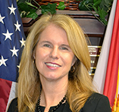
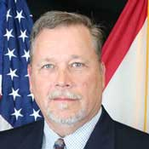
Notes:
Mary Mahew is Secretary for the Agency for Health Care Administration or ACHA. Mary is an innovator and problem solver. Before making the move to Florida, Mary most recently served as the deputy administrator and director of Medicaid and the Children’s Health Insurance Program for the federal Centers for Medicare and Medicaid Services.
Prior to this she was appointed by Maine Governor Paul LePage to be the Commissioner of the Department of Health and Human Services, and prior to this, she was a partner in the public affairs firm of Hawkes & Mayhew and served for 11 years as vice president at the Maine Hospital Association.
Rodney Moore is the Assistant Secretary of Substance Abuse and Mental Health for the Florida Department of Children and Families. He is a Licensed Mental Health Counselor holding a bachelor’s degree in Psychology from Southeastern University and a master’s degree in counseling and human development from Troy State University.
Rodney has clinical and administrative experience in community residential treatment, with DCF and with a Florida Medicaid managed care company. In early 2019, Rodney left the managed care world to re-join DCF as its first Chief Innovation Officer and was recently elevated to Assistant Secretary for Substance Abuse and Mental Health.
Please join me in welcoming Mary Mahew and Rodney Moore.

Slide 19
Panel I
Suicide Prevention Initiatives in the Provider Space

Slide 20

Suicide Prevention Initiatives in Florida’s State Mental Health
Treatment Facilities
Carolyn Drazinic, MD, PhD, MBA
Chief Medical Officer of Substance Abuse and Mental Health
Florida Department of Children and Families
carolyn.drazinic@myflfamilies.com

Slide 21
Financial Disclosures
Dr. Drazinic has no financial relationships to disclose related to the subject matter of this presentation.
Ideas in this presentation are her views and do not represent the views of DCF, the state, or any other entity.

Slide 22
Data that initiated the change
Every suicide, though rare event, is one too many
Most suicide attempts on inpatient units are by hanging
Many are not predictable in advance– hidden intent
New generation has “around-the-clock” peer pressure
  “Bullying with no break” via cell phones, internet
  Texting, sexting, Snapchat, Instagram, Twitter
  Earlier drug/violence/sex exposures
  Rural and suburbs no longer spared
  Goading, daring, public promises
  Social media influences are unpredictable
State hospitals need modernization, renovations

Slide 23
Changes made: suicide prevention measures
Environment– requires large capital investment
  Antiligature
  Video cameras
Patient care
  C-SSRS
  DBT-informed care/Zero-suicide initiatives
  Trauma-informed care (TIC)
  Increase staff monitoring of patients at risk
  More interventions with high risk patients
  Treatment malls
  Increased activities for patients on nights/weekends/holidays

Slide 24
Changes: many in progress
Environment–
  Antiligature– much done, but still in progress
  Video cameras– installed more, need more
    Problems still arise in “blind” areas
Patient care
  C-SSRS- screening and standardization of definitions
  DBT-informed care/Zero-suicide initiatives- in progress
  Trauma-informed care (TIC)- project exploration; decreased R/S
  Treatment malls– NEFSH started in June
  Decreased assaults– significantly less than in the past
  Decreased abuse/neglect reports by patients
  More rapid stabilization with medications
  Decreased lengths of stay in civil and forensic hospitals

Slide 25
Pearls for future of suicide prevention
Environmental changes to state hospitals
  Require large capital investment by the legislature for antiligature initiative and/or new modern hospital buildings
  State hospitals should be seen as leaders in psychiatric care
Patient care initiatives
  Require investments in staff training and maintenance
  Need full staffing levels, updating market-competitive salaries over time
  Research-level investments are needed for new initiatives
    To generate measurable data need an EMR
Change language, change perceptions of mental illness
  Patients should return to community and move on with lives
  Patients, not residents
  Temporary hospitalizations, not homes for a lifetime
  Legal system: don’t criminalize mental illness and make it impossible to work and have housing
  Give hope for a fulfilling life in the future, not despair because you happen to have a mental illness

Slide 26

Thanks for your attention
and for any questions/comments!
Carolyn Drazinic, MD, PhD, MBA
Chief Medical Officer
Substance Abuse and Mental Health
carolyn.drazinic@myflfamilies.com

Slide 27
Digital Proximity
Patient Safety 2019
How Technology Improves Staff Performance and Accountability

Slide 28
We have faced serious events in the past that have led to heightened regulatory scrutiny. In response to these incidents we were faced with the need to improve our rounding procedures.
Centerstone is dedicated to ensuring that we provide a safe environment for our patients and staff, and to do so, we recognized there was a better way to do patient observations.
We have invested in digital proximity: ObservSMART to improve patient safety, decrease risks, meet regulatory requirements and ultimately get us to zero harm.
RCA
PI
Improve Patient Safety

Slide 29

The Change: Accountability in staff performance
Timely
Visual
proximity

Slide 30

Observsmart
Safety becomes #1 priority
Assists staff to perform better
Easy and timely access to best performance
Product is staff friendly
Building staff performance Accountability
Notes:
Improve culture of accountability and mindfullness

Slide 31
Pearls for Implementation in the Future
Super
Users:
who
Where
When
How
Leadership coverage live for 24 hours staff assistance
Establish the staff performance review:
Develop a training guide for staff on units
Troubleshoot the barriers to reach perfect practice with staff
Aim for 100% compliance and offer guidance to improve performance
Addendums: Make sure to add the troubleshooting as you go in your guide/training book.
Create an Observsmart Escalation with your agency
Notes:
Staff performance review:
Correct/assist staff performance daily on the units after launching program for 4 weeks then review weekly. Have a trainer available to re-educate the low performers within the week of findings.
Send report weekly to staff, and address low performers 3 and 4 personally to evaluate barriers to performance. Keep track of low performers to see impact of interventions, progress or lack of.

Slide 32
Saving Lives, the Standardized Way: Empirically Supported Risk Assessment at an FQHC
Citrus Health Network
Matthew S. Michaels, Ph.D., QI Coordinator
Melina Visser, Psy.D., QI Manager

Slide 33


Initiation of Change
Citrus Health Network Background
Historical Suicide Risk Assessment
Transition to Empirically Supported Suicide Risk Assessment
Notes:
Citrus has been a community mental health center since 1979 and a Federally Qualified Health Center since 2004.

Slide 34





Implementation Details
A circular, rather than linear process.
Meetings with stakeholders
Monitoring Compliance
Crafting policy
Modifying our Electronic Healthcare Record (EHR)

Slide 35
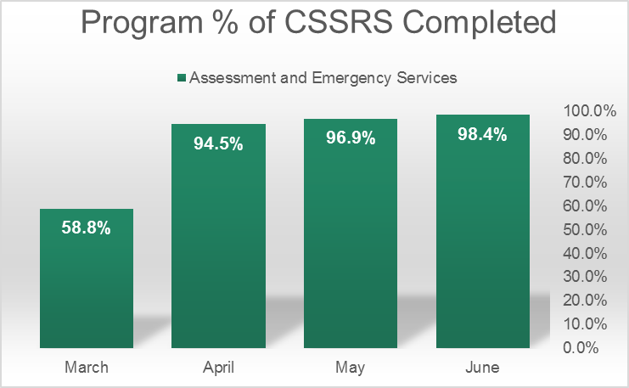
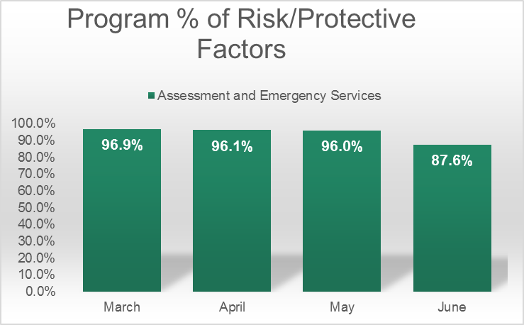
Example Data after Program Change

Slide 36

Lessons Learned
Team Effort
  C-Suite
  Quality Improvement
  Developers
  Direct Service Staff
Zero Suicide
  Creating Cultural Change
Additional Efforts
  Suicide Prevention Task Force
  Enhancing safety plans
  Increasing safety culture efforts

Slide 37
Questions and Comments
Matthew S. Michaels, Ph.D.
Email: MMichaels@citrushealth.com
Phone: 305-817-1196
Melina Visser, Psy.D.
Email: MVisser@citrushealth.com
Phone: 305-424-3022

Slide 38
Using Evidence-based EMDR Therapy for Individuals with Suicidal Ideations or Self-Harm Behaviors
Donna Rininger, LMHC, MCAP,
Certified EMDR Clinician, EMDRIA EMDR Consultant
Director of Specialty Services
Peace River Center

Slide 39
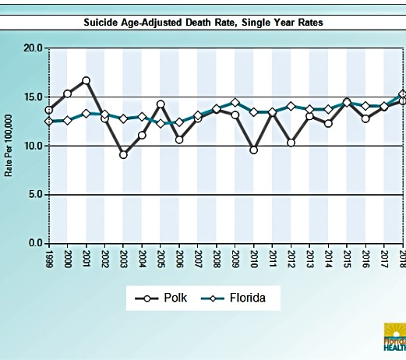
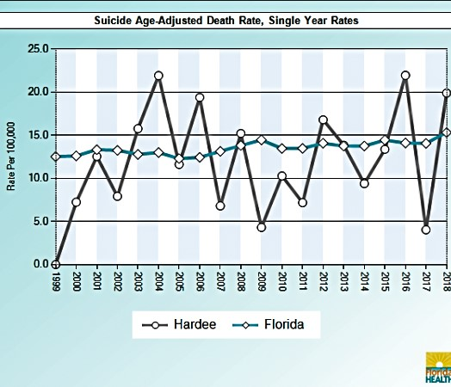
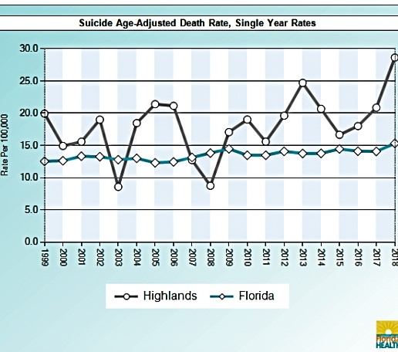
Suicide rates have been rising in nearly every state, according to the latest Vital Signs report by the Centers for Disease Control and Prevention (CDC). In Florida, there were 205,781 involuntary examinations in the 2017/2018 fiscal year. 77.36 % of involuntary examinations in FY17/18 were based on evidence of harm to self. (https://www.floridatrend.com/article/24727/suicide-rates-rising-in-florida-and-across-the-us; The Baker Act Fiscal Year 2017/2018 Annual Report.)
What data prompted change? Circuit 10 Suicide Death Rates 2018
FLHeathCharts.com is provided by the Florida Department of Health Division of Public Health Statistics & Performance Management.
Data Source: Florida Department of Health, Bureau of Vital Statistics

Slide 40
Peace River Center’s Initiatives
EMDR (Eye Movement Desensitization and Reprocessing)
Enables people to heal from the symptoms and emotional distress quickly in just a few sessions
Recognized as an effective form of treatment for trauma and other disturbing experiences by organizations such as the American Psychiatric Association, the World Health Organization and the Department of Defense
  Since 2013, Peace River Center has provided training and certification for 22 therapists across the agency.
  Provided availability of EMDR certified staff to intervene with individuals in our Crisis Stabilization units who were Baker Acted due to suicidal ideations, suicide attempts, or engaging in self-harm behaviors.
  This year, an additional 22 therapists will receive EMDR training to be able to provide this evidence-based therapy to the individuals we serve.

Slide 41
The results are in….
What does the research show?
EMDR therapy was given a strong recommendation as an effective and empirically supported treatment for PTSD in children, adolescents and adults. International Society for Traumatic Stress Studies (2018) Practice Guidelines. http://www.istss.org/treating-trauma/new-istss-prevention-and-treatment-guidelines.aspx.
EMDR therapy appears to be a promising new treatment to prevent suicidal behavior as it potentially targets one of the linking pins between suicidal ideation and suicidal actions. van Bentum, J., Sijbrandij, M., Huibers, M., Huisman, A., Arntz, A., Holmes, E., & Kerkhof, A. (2017, April). Treatment of intrusive suicidal imagery using eye movements. Preprints, 2017040152. doi:10.20944/preprints201704.0152.v1.
Eye movements during EMDR therapy resulted in decreased ratings of image vividness and emotional intensity. Engelhard, I.M., van den Hout, M.A., Janssen, W.C., & van der Beek, J. (2010). Eye movements reduce vividness and emotionality of ‘‘flashforwards.’’ Behaviour Research and Therapy, 48, 442–447.
Sample Peace River Center Case Studies:
33 year old female admitted to our CSU following a serious suicide attempt requiring intensive medical treatment and reparative surgery. The individual could not be stabilized on the CSU and was admitted to our SRT. While there, a certified EMDR clinician met with her 7 times, including one session for evaluation, one session for preparation for EMDR therapy, four EMDR processing sessions, and a final session to assess for residual symptomology and possible risk before discharge. In a follow-up one year later, the individual reported no further behaviors of self-harm, was in college, had changed careers, and was reunified with her child. She attributed her success to the four EMDR processing sessions while at our SRT.
14 year old female admitted to our CSU due to on-going self-harm behaviors. Individual had a history of sexual battery from the ages of 5-12 by her father. Father was arrested and deported back to his mother country. The child continued to attempt to self-harm on the unit, despite one-on-one monitoring. A certified EMDR clinician met with the child on the unit at the mother and treatment team’s request. Once EMDR therapy began, all self-harming behaviors ceased while on the unit. Upon discharge, counseling continued with her regular PRC therapist. Staffings between the regular therapist and the EMDR therapist revealed no further self-harming behavior and the child was doing much better emotionally regarding past abuse.

Slide 42
Further implementation in the future….
EMDR protocols have been developed so it can be taught to first responders or other non-mental health emergency personnel working within a structured response team and in a setting that includes supervision/consultation- the Immediate Stabilization Procedure (ISP®- Dr. Gary Quinn) and Acute Traumatic Incident Processing (A-TIP). These protocols utilize bilateral stimulation that may be used by para-professionals to immediately desensitize acute stress in crisis situations.
Continued training on EMDR therapy for therapists across the agency in a variety of programs for a variety of client populations
Training for our mobile Crisis Response Team staff in the use of ISP or A-TIP to immediately address trauma of individuals in acute crisis on the scene

Slide 43
Panel I
Q&A

Slide 44
Panel II
Integrating Suicide Prevention and Collaboration in the Community

Slide 45
Suicide Prevention:
It Takes a Village
Melissa Larkin-Skinner
Centerstone

Slide 46
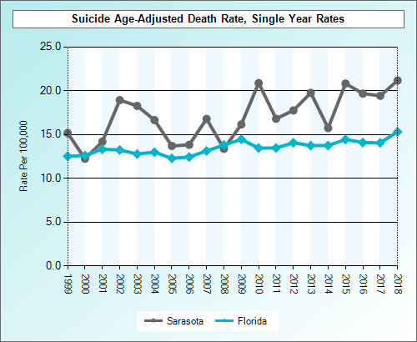
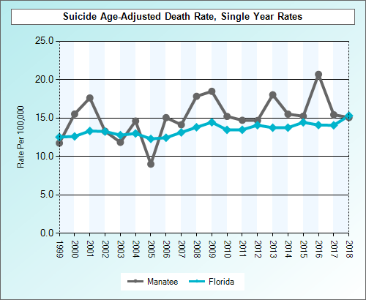
The Data
2nd leading cause of death for 15-24 y/o
1.3 million people attempted
> 25% increase since 1999
47,173 deaths
>50% have no MH Dx

Slide 47
The Village
Government
Service Orgs
Faith
Schools
Business
Foundations
Health Care
Justice
First Responders

Slide 48
The Responsibility:
Engage * Educate * Motivate
Community Leaders
  School superintendent
  County/city commission
  Local State legislators
  Chamber of commerce
  Foundation directors
  Sheriff
  Police chief
  Faith leaders
  Civic leaders
Opportunities
  Individual meetings
  Public meetings
  Awareness events
  Mental Health first aid/youth mental health first aid
  Foundation directors
  Classrooms
  Training events

Slide 49


The Goal: Zero Suicides

Slide 50
Melissa Larkin-Skinner, MA, MBA, LMHC
Melissa.larkin-skinner@Centerstone.org
(941) 720-4826

Slide 51


Slide 52

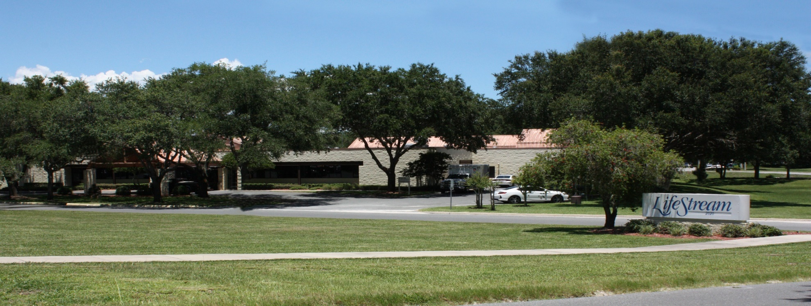
LifeStream Behavioral Center
LifeStream is a comprehensive integrated health system, providing behavioral health, primary healthcare and social services to approximately 24,000 Central Florida residents annually. LifeStream’s continuum of care includes crisis intervention, inpatient, outpatient, and residential treatment, primary care, child welfare, educational, care management, rehabilitation, homeless and housing programs.

Slide 53
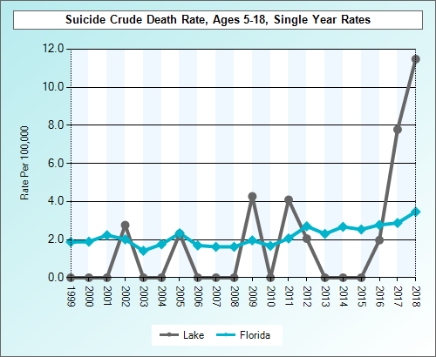
Why was the program initiated?
Large increase in the number of Baker Acts, with many children having serious plans to harm themselves
Crisis Stabilization Unit recidivism rates were at an all-time high
In a matter of weeks, five teens completed suicide in South Lake County, along with 20 attempts

Slide 54
What is the program?
LifeStream adopted the Zero Suicide Framework and LINC (Linking Individuals to Needed Care) by incorporating the following:
  System-wide culture change committed to reducing suicides
  Training a competent, confident, and caring workforce
  Identifying individuals with suicide risk via comprehensive screening and assessment
  Engaging all individuals at-risk of suicide using a suicide care management plan
  Treating suicidal thoughts and behaviors using evidence-based treatments
  Transitioning individuals through care with warm hand-offs and supportive contacts
  Creating care management and care coordination component (LINC)

Slide 55
What is the program impact?
November 2016: 150 participants
Mental Health, Suicide Ideation/Attempt and Readmission Outcomes were tracked from baseline to 90 days post discharge
Tools used: PHQ9, Columbia Suicide Severity Rating Scale and Admission Records
The results show statistically significant decreases over time:
  PHQ 9: scores range from 0-27 with higher scores indicating severe depressive symptoms.
Mean Score (SD) Baseline | Mean Score (SD) 30 Days | Mean Score (SD) 60 Days | Mean Score (SD) 90 Days
16.98 (6.26) | 7.10 (6.14) | 7.49 (6.41) | 5.92 (6.22)

Slide 56
What is the program impact?
C-SSRS (Suicide Ideation): Suicide ideation scores range from 0-5 with higher scores indicating higher levels of suicide ideation. Suicide ideation among participants significantly decreased over time with a peak reduction by 30 days.
C-SSRS (Behavior): At baseline, 44% reported they had attempted suicide. The number of participants who reported making a suicide attempt decreased over time.
Mean Score (SD) Baseline | Mean Score (SD) 30 Days | Mean Score (SD) 60 Days | Mean Score (SD) 90 Days
2.98 (1.68) | 0.62 (1.31) | 0.99 (1.59) | 0.82 (1.49)
N (%) Baseline | N (%) 30 Days | N (%) 60 Days | N (%0 90 Days
63 (44.3%) | 15 (18.7%) | 24 (33.8%) | 21 (30.4%)

Slide 57
Pearls of wisdom...
Training of staff is essential
Care coordination activities for at risk youth and their families is necessary, especially post discharge
The family needs to be part of the focus in post discharge services
Safety plans that are developed in a collaborative and patient centered manner appear to be more effective
Communication and contacts are critical to saving lives with this population

Slide 58
THANK YOU FOR YOUR ATTENTION!!
Rick Hankey
Executive Vice President
LifeStream Behavioral Center, Inc. Email: rhankey@lsbc.net
Phone: 352.315.7507

Slide 59
Implementation of SAMHSA’s Garrett Lee Smith Act Grant in Florida
Lindsay Brown, Director of Training & Community Engagement
Florida Linking Individuals Needing Care (FL LINC) Project

Slide 60
FL LINC Program Initiation
FUNDING: SAMHSA Garrett Lee Smith Grant (2015-2019)
RESEARCH: UCF + USF
STATE PARTNERS: Florida Behavioral Health Association + Statewide Office of Suicide Prevention
PURPOSE: Systems-level change to identify youth at-risk for suicide and ensure continuity of care
TARGET REGIONS: Based on youth suicide death rate data + partnered with managing entities Central Florida Cares Health System (CFCHS), Lutheran Services Florida (LSF), Southeast Florida Behavioral Health Network (SEFBHN)

Slide 61
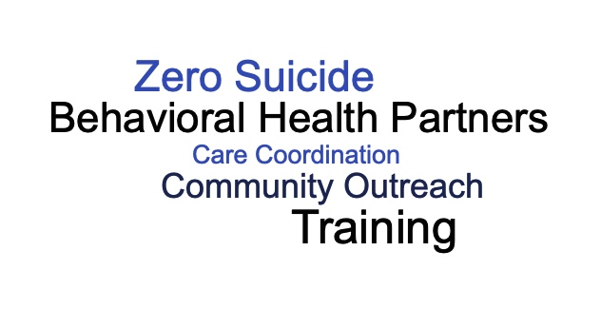
Program Components

Slide 62
Outcomes
8,046 trained in gatekeeper prevention programs
1,525 trained in advanced intervention programs
18,240 educational resources distributed
47,131 NSPL materials disseminated
509 children served in care coordination services
  Significant reduction in mean PHQ-9 screener scores (16.89 at intake reduced to 5.96 at discharge)
  Significant reduction in mean C-SSRS assessment scores (2.91 at intake reduced to 0.44 at discharge)
  Up to 93% engaged in MH services during program involvement
  89% still remained in these services at discharge
50+ BHO programs received ZS technical assistance

Slide 63
Future Directions
Systems-change essential for lasting training effects
Zero Suicide technical assistance funded at state-level for BHOs
Implementation of ZS in other sectors: primary care, juvenile justice, child welfare, and schools
Florida Implementation of the National Strategy for Suicide Prevention (FINS) Project – implementation of FL LINC model within Advent Health emergency departments, targeting adults

Slide 64
Panel II
Q&A

Slide 65
Panel III
Integrating Suicide Prevention and Collaboration in the Community Continued…

Slide 66
State of the Bay:
Tampa Bay’s Suicide Indicators
Recommended next steps
A collaboration between BayCare Behavioral Health and University of South Florida

Slide 67

Mental Health & Mental Disorders
Overall, 15.02% of respondents reported the inability to access needed mental health services in the last 12 months (N=375)
Of these, 32.07% reported cost/affordability being the biggest barrier to care
Healthy Communities Institute – All Rights Reserved – Private & Confidential

Slide 68
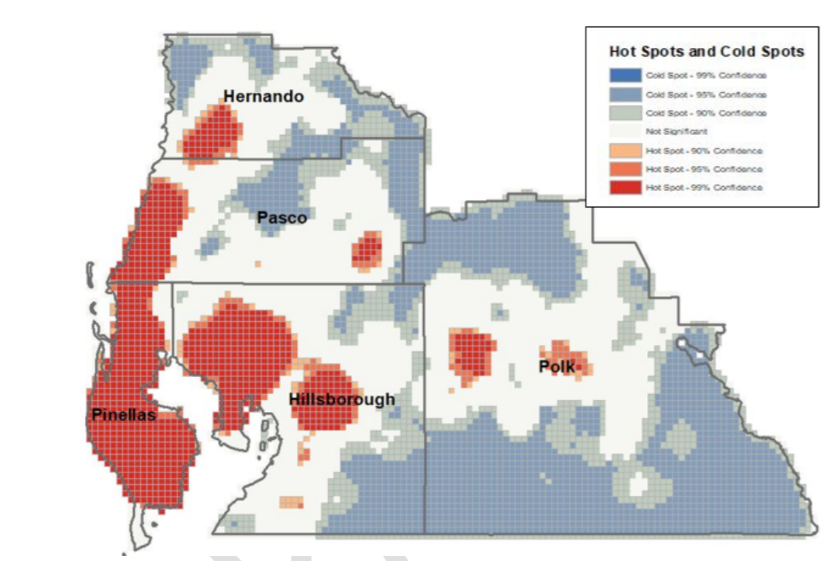
Figure 1: Suicide Hot Spots

Slide 69
Conclusions
Pinellas, Pasco, and Hernando bear a disproportionate burden of suicide mortality
Middle and older aged, white men have the highest rates of suicide
Many were military
Guns
80% who died by suicide never had an involuntary examination
Of the 20% - the suicide happened 1 or more years after

Slide 70
Table 5: Latent Profile Analysis of Community Characteristics of Census Tracts in 5 Tampa Bay Area Counties
 | Group 1 | Group 2 Highest Suicide Risk | Group 3 | Group 4 | Group 5 Lowest Suicide Risk
Suicide Rate | 18.5 | 38.3 | 15.3 | 13.1 | 11.1
Disability Percent | 26.4 | 19.0 | 14.3 | 12.2 | 15
Minority Percent | 9.5 | 19.3 | 20.4 | 46.2 | 78.9
Age < 17 Percent | 6.5 | 15.4 | 18.9 | 23.4 | 26.7
Uninsured Percent | 9.0 | 17.0 | 11.6 | 16.5 | 22.3
Poverty Percent | 11.5 | 17.7 | 9.1 | 17.9 | 31.9
Opioid-Related Death Rate | 3.8 | 6.4 | 2.8 | 1.0 | .37
Gun-Related Suicide Rate | 10.3 | 17.7 | 8.2 | 6.3 | 5.0
Gunshop Rate | 27.1 | 29.3 | 19.1 | 18.0 | 20.3
Liquor Store Rate | 285.1 | 452.3 | 205.5 | 222.0 | 315.0
Church Rate | 64.5 | 114.5 | 76.2 | 109.3 | 219.0
Opioid-Related Provider Rate | 18.0 | 48.0 | 16.4 | 27.9 | 40.6
Age > 65 Percent | 54.0 | 25.2 | 21.5 | 12.9 | 12.1
Mobile Home Percent | 28.3 | 20.1 | 10.3 | 10.7 | 6.33
Means of Profiling Variables and Correlates for Each Latent Profile Group.
Profiling Variables: Suicide Rate, Disability Rate, Minority Rate, Age < 17, Uninsured Rate, Poverty Rate.
All rate variables reflect rates per 100,000. For suicides & death, rates are annualize. All other variables reflect % for the census tract.

Slide 71
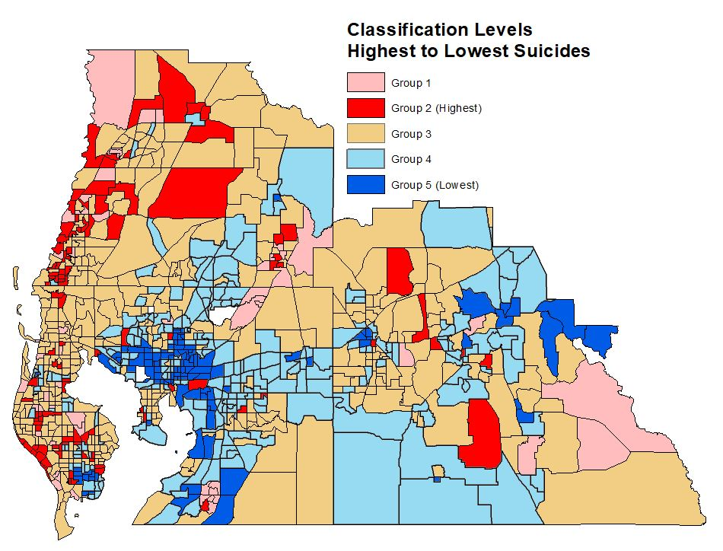
Figure 12: Cluster Analysis Results – 5 Clusters Mapped in 5 Counties in Tampa Bay Area

Slide 72
The Bundle: A Public Health initiative
An evidence based methodology for community success
Public Health
Build life skills and resilience
Increase help-seeking behavior Identify and assist persons at risk (MHFA)
Reduce access to lethal means (firearm storage)
Strengthen economic supports
Clinical Services
Provide mental health, substance use and violence crisis services Provide evidence based care Support care transitions
Provide postvention or aftercare supports

Slide 73

NAMI Florida Initiatives
Cindy Foster
NAMI Florida
Education Program Director
September 25, 2019

Slide 74
Informing Middle & High School Students about Mental Health
Began in 2014 to reach adolescents in one 45-50 minute middle and high school class period
Goal: “To create a generation of students who are well-positioned to end the silence and stigma surrounding mental illness.”
Slides include:
  Know the WARNING SIGNS of Suicide: Someone needs IMMEDIATE attention
  What YOU Can Do: Take warning signs seriously Take action IMMEDIATELY
Notes:
Data that initiated the program/change
Know Signs: *Talking, writing or drawing about death, *Talking about – having no reason to live – being a burden to others – not being here tomorrow *Looking for ways to attempt suicide * Feeling hopeless, desperate or trapped *Giving away possessions *Behaving recklessly
What YOU Can Do – Take action IMMEDIATELY: *Ask the question “Are you thinking about suicide?” *Don’t leave them alone *Tell an adult you rust *Call the National Suicide Lifeline at 1-800-273-TALK *Go to an emergency room or call 911 *Don’t keep suicide warning signs a secret

Slide 75
NAMI ETS Improvements
NAMI Ending the Silence expanded a full package:
  ETS for Students
  ETS for School Staff
  ETS for Family Members
Resource cards for students, staff and family members include:
  the 24/7 Crisis Text Line and National Suicide Prevention Lifeline
  The 10 warning signs of mental health conditions
  Trained school staff can post cards in their classroom
Notes:
Details of the program/change that was initiated
The former education program “NAMI Parents and Teachers as Allies” was updated in 2018 to match NAMI Ending the Silence. ETS for Students, ETS for School Staff and ETS for Families.

Slide 76

Evidence Based and ETS
SAMHSA and NREPP (National Registry of Evidence Based Programs and Practices)
ETS Research
Students, School Staff and Family members in Florida
Notes:
Data after the program change
After the Evidence Based Research a NAMI article was published in the May 2018, Vol 49 No. 5 American Psychological Association Monitor on Psychology A one-hour educational program can reduce stigma around mental illness, finds a study in Stigma and Health. More than 500 students across the United States (Participants were primarily ninth and tenth grade students recruited from schools in five different areas of the United States—Arizona, California, Florida, Illinois, and Texas) watched an hour-long slide and video presentation from the National Alliance on Mental Illness called "Ending the Silence," which included information on the warning signs of mental health conditions, videos made by teens to encourage support for peers with mental illness and a talk by a young adult who discussed his or her own experience with mental illness. Students were assessed on their knowledge of and attitudes toward mental illness at three points: before the presentation, immediately after and four to six weeks later. Students who watched the presentation gained more knowledge about what to do if one of their peers showed signs of mental illness and had fewer negative attitudes toward people with mental illness, compared with a control group of peers at the same schools who had not seen the presentation.
I will provide the latest reported data in Florida on ETS for Students, ETS for School Staff and ETS for Family Members.

Slide 77
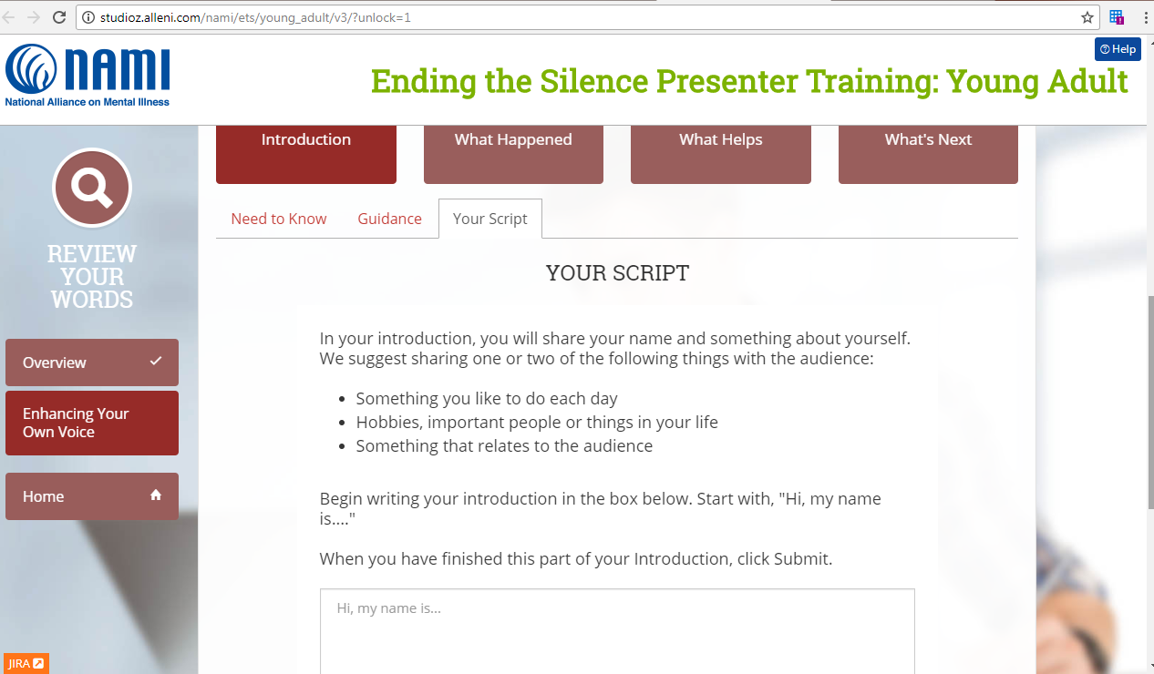
Pearls for NAMI ETS Implementation in the Future
Lead and Young Adult Presenters Have a Lived Experience
Invitations from School Districts
Funding
Notes:
Pearls for implementation in the future

Slide 78
Have Questions?
CONTACT ME!
Cindy Foster programs@namiflorida.org

Slide 79

FSU’s Professional Certification in Trauma and Resilience
https://learningforlife.fsu.edu/professional-certification-trauma-and-resilience-level-one/
Karen Oehme, J.D.

Slide 80
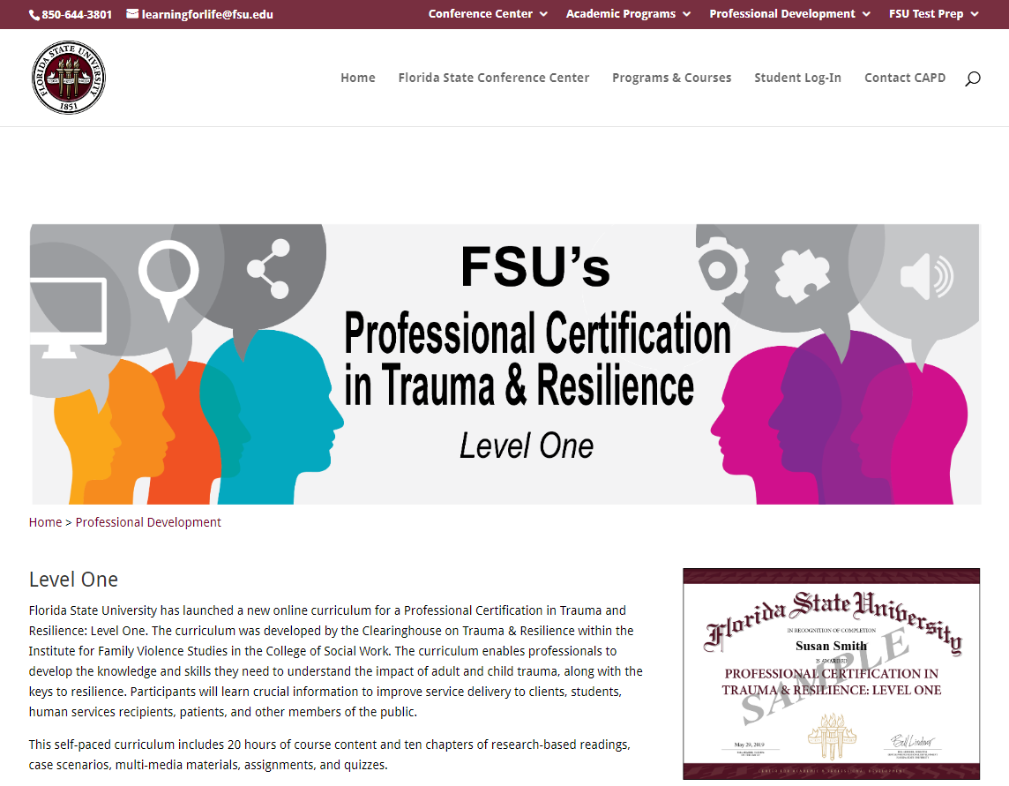

Slide 81
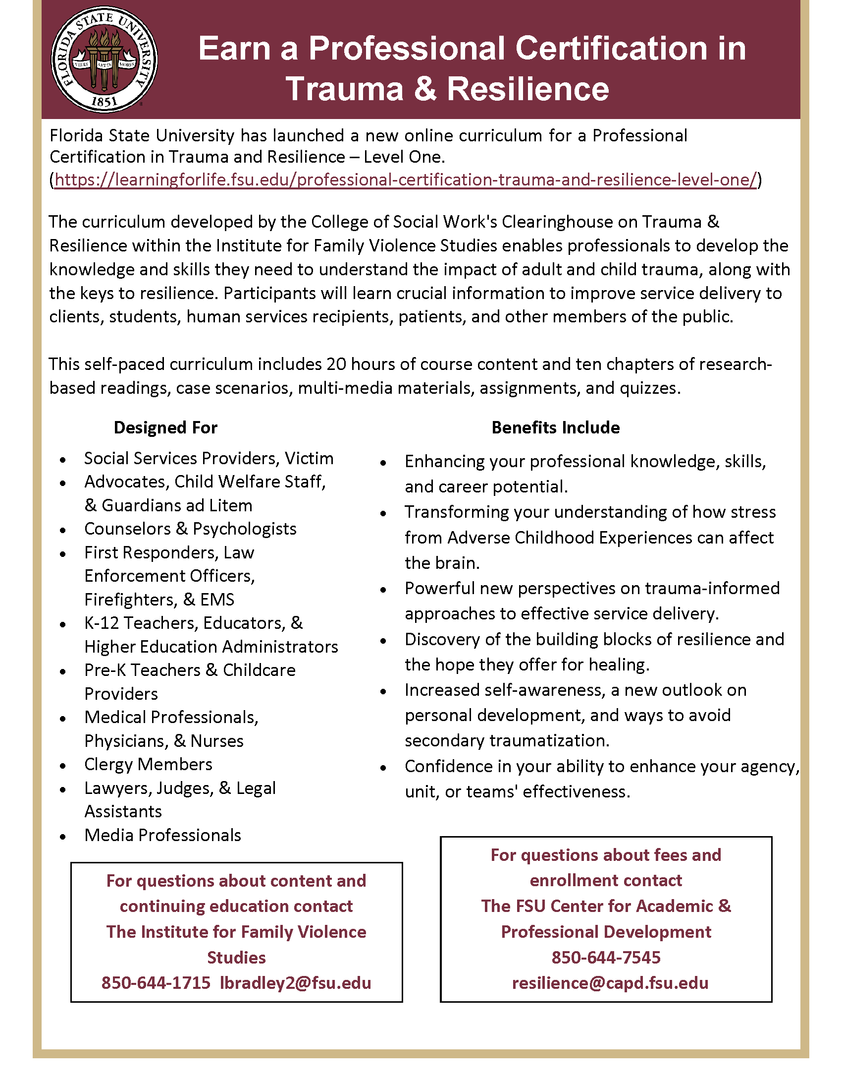

Slide 82
Certification Overview
Seeking common language
Acknowledging professional expertise and effort
Multi-disciplinary approach is key
May be too basic for some
Complements prior trainings
Provides inclusive lens
CEU’s included for many professionals

Slide 83
Contact Us
Karen Oehme
Director
Institute for Family Violence Studies
College of Social Work
koehme@fsu.edu

Slide 84

Florida Behavioral Health Association
Suicide Summit
September 2019

Slide 85

A Better You
At WellCare, we understand being healthy is affected by so many parts of your daily life.
We provide healthcare that gets you to the right doctors and specialists.
We also connect you with other services and organizations that can help you manage the many challenges of your life.
Because we believe a more integrated approach to your health means a better you.

Slide 86
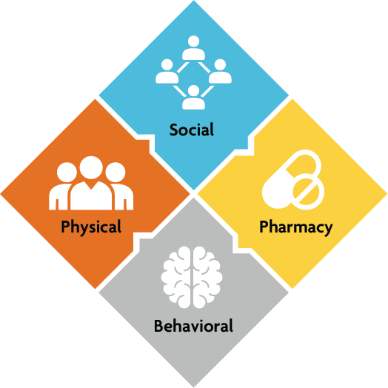
Model of Care
WellCare uses a holistic, customized approach to care for our members based on their unique physical, behavioral, pharmaceutical and social needs
  WellCare uses a proprietary, clinical platform to identify and stratify members’ needs into four areas, which improves care coordination and appropriate utilization.
  Addressing members’ social needs is an important part of the solution. When members are connected to services like job, education and utility assistance, we see:
    Improved medication adherence rates;
    Increased independence;
    Lower hospital admissions; and,
    Improved physical and behavioral health outcomes.

Slide 87
WellCare’s Presence
6.3M
MEMBERS
607K
HEALTHCARE
PROVIDERS
68K
PHARMACIES
14K
ASSOCIATES
#155
FORTUNE 500
Medicaid
Medicaid &
Medicare Advantage*
Medicare Prescription Drug Plans (50 U.S. states & D.C.)
Medicare Advantage
Medicaid (Pending) & Medicare Advantage†
Health Insurance Marketplace
*Includes states where the company receives Medicaid and Medicare revenues associated with Dual Eligible Special Needs Plans (D-SNPs)
† Anticipated beginning Nov. 1, 2019, WellCare of North Carolina will administer the state’s Medicaid Prepaid Health Plans (PHPs).
All numbers are as of June 30, 2019
Notes:
Founded in 1985 in Tampa, Florida:
Serving 6.3 million members nationwide
607K contracted healthcare providers
136K contracted healthcare facilities
68K contracted pharmacies
Serving 4.1 million Medicaid members in 13 states:
Aged, Blind and Disabled (ABD)
Dual-eligible populations (Medicare and Medicaid)
Intellectual Developmental Disabilities (IDD)
Children’s Health Insurance Program (CHIP)
Managed Long-Term Services and Supports (MLTSS)
Supplemental Security Income (SSI)
Temporary Assistance for Needy Families (TANF)
Serving Medicare members in 22 states:
560,000 Medicare Advantage members
1.6 million Prescription Drug Plan (PDP) members
11 Accountable Care Organizations (ACOs) and 1 Care Transformation Organization (CTO)
Significant contributor to the national economy:
14K associates nationwide
Offices in all states where the company provides managed care
Ranked #155 on the Fortune 500

Slide 88
WellCare’s Presence in Florida
Holmes
1.2M
MEMBERS
Escambia
Santa Rosa
Okaloosa
Washington
Jackson
Nassau
Walton
Gadsden
Jefferson
Hamilton
Bay
Calhoun
Leon
Madison
Columbia
Baker
Duval
Liberty
Wakulla
Taylor
Suwannee
Union
Clay
Gulf
Franklin
Lafayette
Bradford
Saint
Dixie
Gilchrist
Alachua
Putnam
Johns
Levy
Flagler
6,300
ASSOCIATES
23
OFFICES STATEWIDE
Marion
Citrus
Lake
Volusia
Sumter
Seminole
Hernando
Orange
Pasco
Pinellas
Hillsborough
Polk
Osceola
Brevard
Manatee
Indian River
42K
PROVIDERS
13K
FACILITIES
Hardee
Okeechobee
Saint Lucie
Sarasota
Desoto
Highlands
Martin
Charlotte
Glades
Lee
Hendry
Palm Beach
Broward
$7.5B
DIRECT STATE ECONOMIC IMPACT
Collier
Miami-Dade
Monroe
Monroe
88
Counties with WellCare offices
*Economic impact based on CY2018 internal projections, including direct, indirect and induced benefits.
All numbers are as of June 30, 2019

Slide 89
SAMSHA –
HRSA Center for Integrated Health Services
SAMSHA – HRSA Center for Integrated Health Services –
“Every 15 minutes someone in the U.S. takes his or her own life. And for every one suicide, there are 25 attempts. This public health issue affects everyone: families, healthcare providers, school personnel, faith communities, friends, government, and others. It’s important that everyone know suicide’s warning signs and how to help a person contemplating suicide. This is particularly true for healthcare providers, especially those who work in integrated health settings, which are primed to make a great difference in the lives of people at-risk of suicide”

Slide 90
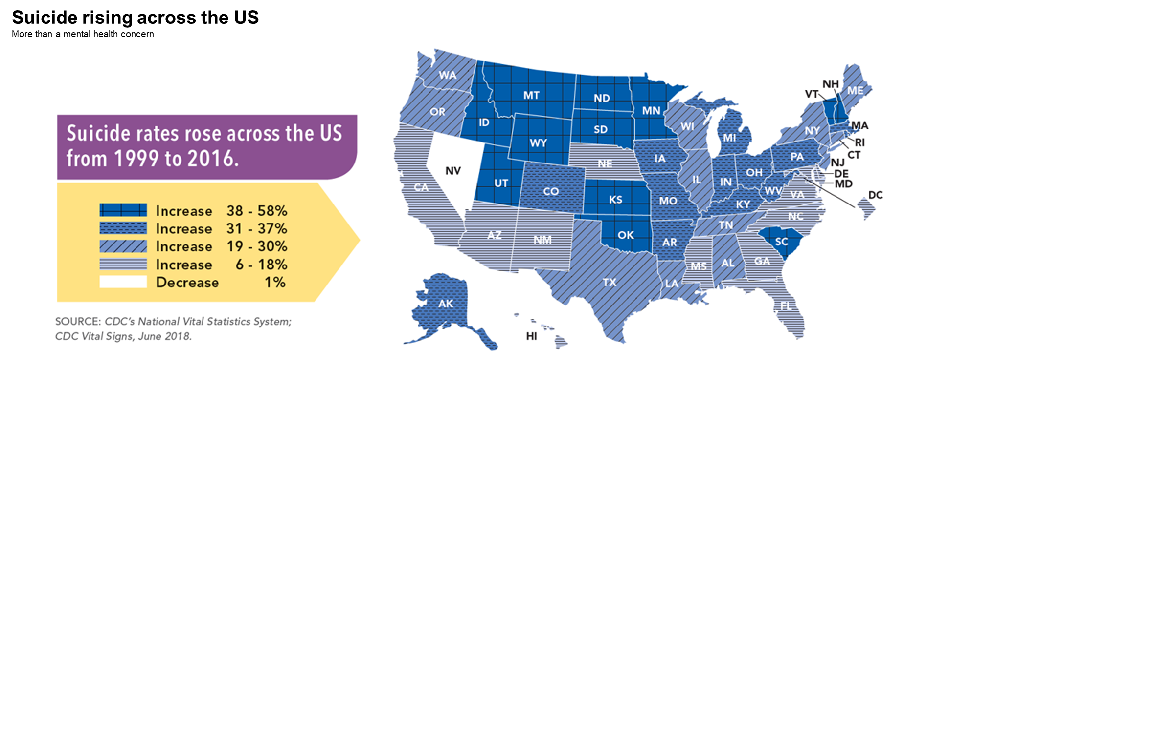
CDC Statistics
Note - Florida Rate– Increase of 10.8%

Slide 91
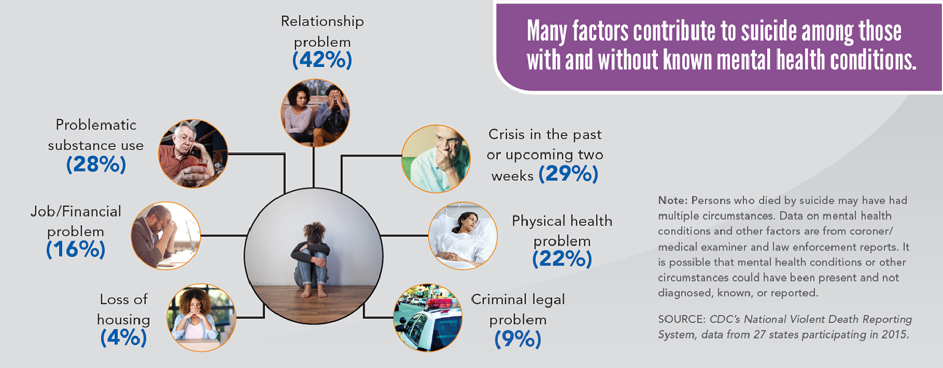
CDC Statistics

Slide 92
WellCare Initiatives
Mental Health First Aid
Lunch and Learns on Suicide Prevention
Integrated Health Homes
  Behavioral Health Homes
Screening in PCP Offices
No Prior Authorization/Referral for Behavioral Services
Tele Behavioral Health Services – Evening and Weekend Appointments
Member Education
  Suicide Awareness
  Disease Management
ILOS – Mobile Crisis, Peer Support, Wraparound etc.
Zero Suicide Program
Community Events
Welcome Rooms

Slide 93


Slide 94
Panel III
Q&A

Slide 95
Notes:
Good morning. My name is Bill Gardam, I am the CEO of Peace River Center, a full-service community mental health center serving Polk, Highlands and Hardee Counties since 1948.
We serve over 25,000 patients a year through 30 programs provided in 27 locations and offering traditional inpatient and outpatient services and operating a psychiatric crisis line and mobile crisis response team for over 17 years that specifically responds to crisis calls and suicide issues.
I am also the Board Chair of the Florida Behavioral Health Association now proudly representing over 72 of Florida’s behavioral health providers statewide.
I am pleased to be here with you today to open this year’s Behavioral Health Innovation Summit with a focus on Suicide Awareness, Assessment & Prevention.

